Slide 1
A morphable model for the synthesis of 3D faces
Feng Wang
AIRD, Coretronic Co.
June 24, 2019
The slides and a list of references can be found from
https://github.com/fwcore/object-detection

Slide 2
Outlines
2D-to-3D and 3D-to-2D workflow
3D morphable face model
build model from 3D face database
modeling facial attributes
3D correspondence using optic flow
Matching a morphable model to images
matching 3D scan
matching 2D image
Blanz & Vetter (1999) A morphable model for the synthesis of 3D faces.

Slide 3
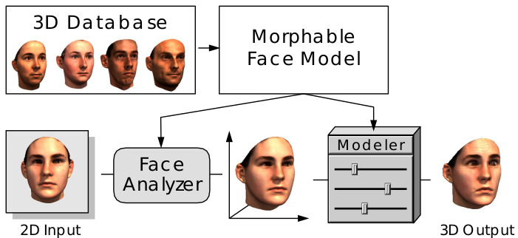

2D-to-3D and 3D-to-2D workflow
2D output
Blanz & Vetter (1999) A morphable model for the synthesis of 3D faces.

Slide 4
Outlines
2D-to-3D and 3D-to-2D workflow
3D morphable face model
build model from 3D face database
modeling facial attributes
3D correspondence using optic flow
Matching a morphable model to images
matching 3D scan
matching 2D image
Blanz & Vetter (1999) A morphable model for the synthesis of 3D faces.

Slide 5
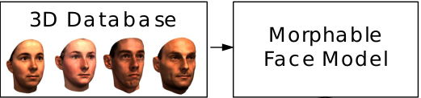
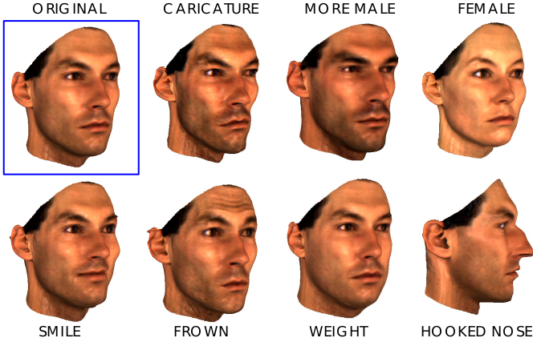
3D morphable face model
3D database (1999)
CyberwareTM laser scans
100 young male and 100 young female
r(h, ϕ), R(h, ϕ), G(h, ϕ), B(h, ϕ)
512 equally-spaced in ϕ, ~70,000 vertices
no makeup, accessories, facial hair. Wearing bathing cap, and removed digitally.
Spec. of morphable face model (1999)
being real face-like
easy to change facial attributes

Slide 6


build model from 3D face database
3D face
shape vector (x1, y1, z1, x2, y2, z2, ...)
texture vector (R1, G1, B1, R2, G2, B2, ...)
3n+3n dimensional vector n: number of vertices
m: number of faces in database
m << n
Assumptions:
Gaussian distribution in 6n dim. space
shape and texture are independent (to generate more faces)
face subregions are independent (to further increase the possible faces). Require blending the borders later on.
Gaussian = PCA:
PCs are decorrelated and Gaussian distributed.

Slide 7
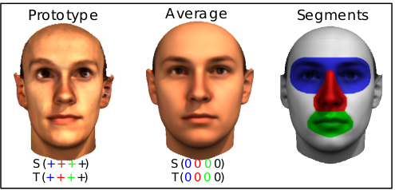
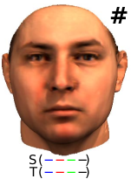
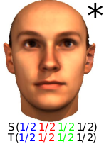
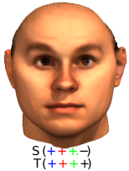
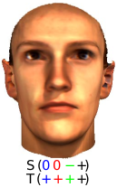

modeling facial attributes: linear model
μ_{i}: facial attribute (obtained by regression)
gender, fullness of faces, darkness of eyebrows, double chins, hooked vs. concave noses.

Slide 8

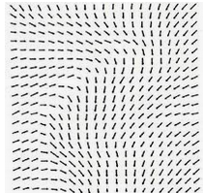

Preparing database: 3D correspondence using optic flow
Key problem: build a point-to-point correspondence between vertices of faces.
Mathematically: consistently label vertices by 1 to n
3D scans
r(h, ϕ)
R(h, ϕ), G(h, ϕ), B(h, ϕ)
3D face
shape vector (x1, y1, z1, x2, y2, z2, ...)
texture vector (R1, G1, B1, R2, G2, B2, ...)
?
flow-field/correspondence
minimize
unregistered
face
+
quadratic coupling between neighboring flow
reference
face
+ mean curvature (optional)

Slide 9
Preparing database: bootstrapping
optical
flow
3D scans
r(h, ϕ)
R(h, ϕ), G(h, ϕ), B(h, ϕ)
3D face
shape vector (x1, y1, z1, x2, y2, z2, ...)
texture vector (R1, G1, B1, R2, G2, B2, ...)
Gaussian
3D approximation as reference
3D morphable model
S, T
alpha, beta
We need tech to approximate 3D scans by 3D morphable model.

Slide 10
Outlines
2D-to-3D and 3D-to-2D workflow
3D morphable face model
build model from 3D face database
modeling facial attributes
3D correspondence using optic flow
Matching a morphable model to images
matching 3D scan
matching 2D image
Blanz & Vetter (1999) A morphable model for the synthesis of 3D faces.

Slide 11

matching 3D scan
minimize by varying α, β

Slide 12
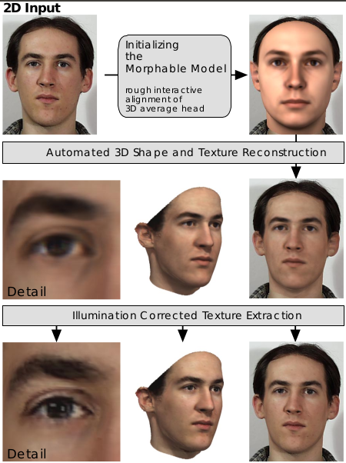
matching 2D image
3D Model parameters
α, β
rendering ρ:
camera position,
object scale,
image plane rotation & translation,
intensity of ambient light,
intensity of directed light,
color contrast, offset, and gain in RGB channel
(fixed & estimated by user) camera distance
(fixed & estimated by user) light direction
(fixed & estimated by user) surface shininess

Slide 13
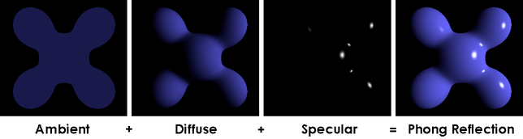

matching 2D image
3D Model
α, β
ρ
perspective
projection
2D image
ambient
light
directed
light
specular
refection
minimize
L2 regularization

Slide 14
Coarse-to-fine
start iteration with down-sampled input image and low-resolution 3D model.
slowly add more α, β and principle components during optimization
start with strong regularization and then slowly reduce it
finally, fixed ρ and change to segmented 3D model to improve details
illumination-corrected texture extraction: extract raw-image details and overlay.

Slide 15
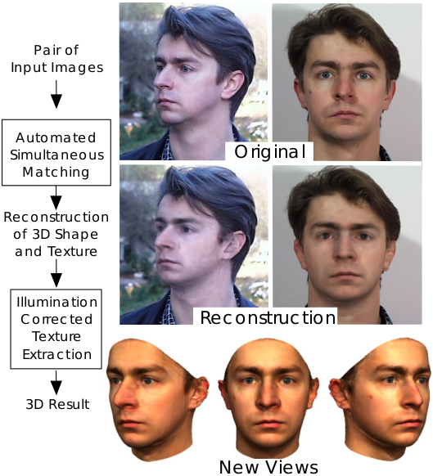
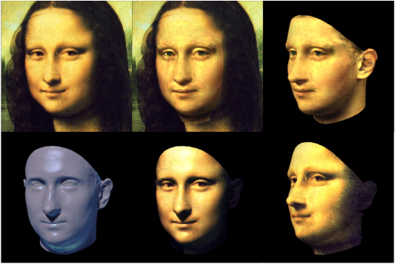
Examples
two -> one
Performance: 50 min on SGI R1000 processor (1999)

Slide 16
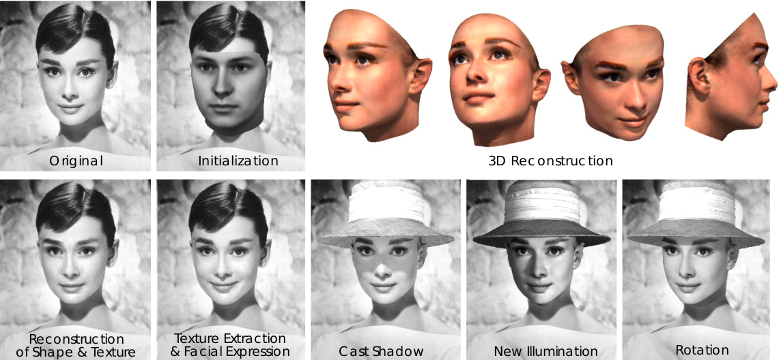

Slide 17
Open questions
Extending the database:
mainly Caucasian of middle age
facial expressions, visemes, face variation during speech (limited by the slow laser scan ~ 10 sec/scan)
Extending the model:
include hair

